Slide 1
GA Fundamental Theorems
Tian-Li Yu
tianliyu@ntu.edu.tw
Department of Electrical Engineering
National Taiwan University
Acknowledgment
David E. Goldberg’s slides for his GA course.
Ying-Ping Chen’s slides for his EC course.

Slide 2
Agenda
Schema theorem
Takeover & drift
Control map
Problem difficulty
BB hypothesis
Time-to-convergence
Population sizing
No-free-lunch (NFL) theorem

Slide 3
Derive the Schema Theorem
Holland (1975).
Ensure the growth of best schema on average.
Conservative bound: ignores several favorable possibilities.
Considers effect of different operators:
selection: proportionate
crossover: one-point
mutation: simple bitwise

Slide 4
Schema
Schemata (pl.)
Introduce the wild card ‘*’.
“1*0” denotes 100 and 110; we call 1 and 0 as fixed.
Order of schema H: o(H)
The number of fixed positions.
o(1**0*) = 2
Defining length of schema H: δ(H)
Distance between the 1st and the last fixed positions.
δ(1**0*) = 4-1 = 3

Slide 5
Schemata Growth: Selection
Selection pressure on H
m(H): # of individuals in the population that belong to H.
The average fitness changes over time.
Exponential growth at the beginning.
Saturated when population is nearly converged.

Slide 6
Schemata Disruptions
One-Point XO:
Mutation:
Lower bounds.
Innovation not considered.

Slide 7
The Schema Theorem
If m(H,t+1) > m(H,t), the schema H grows.
Lower-bound estimation of schema growth.
Consider only destructive forces.
Minimal, sequential, superior (ms²) schemata grow.

Slide 8
Agenda
Schema theorem
Takeover & drift
Control map
Problem difficulty
BB hypothesis
Time-to-convergence
Population sizing
No-free-lunch (NFL) theorem

Slide 9
Takeover & Drift
GA takeover
When consider selection only, the time that the best individual takes over the population (or all but one).
Truncation selection
Tournament selection
Proportionate selection
Genetic drift: convergence for no (good) reason.

Slide 10
Takeover Under Truncation Selection
Truncation selection: make s copies each of
top (1/s)-th of the population.
P(t): proportion of the best guy at generation t.
P(t+1) = sP(t) until P(t) = 1
P(t) = s^{t}P(0), P(0)=1/n.
Solve for takeover time t* s.t. P(t*)=1
time to go from one good guy to all good guys.
t* = lnn / lns

Slide 11
Takeover Under Tournament Selection
When does worse guys win?
Q(t): proportion of worse guy at generation t.
Q(t+1) = Q (t) ^ s.
Q(t) = Q(0) ^ (s^{t}), Q(0)=(1 - 1/n).
Solve for takeover time t* s.t. Q(t*)=1/n.

Slide 12
Takeover Under Tournament Selection (contd.)

Slide 13
Note On Approximation
?

Slide 14
Note On Approximation (contd.)

Slide 15
What Went Wrong?
x and n are roughly of the same order.
does not tend to zero when n large

Slide 16
Takeover Under Proportionate Selection
Probability of selection:
Proportions emphasized according to
Takeover time depends on f
In continuous cases, f (x) = x^{c} and f (x) = e^{cx}
Reference:
Goldberg & Deb (1991). A Comparative Analysis of Selection Schemes Used in Genetic Algorithms.

Slide 17
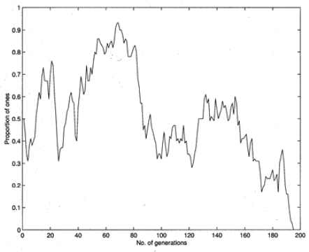
Genetic Drift
Convergence for no good reason.
Population of single-bit strings under little or no selection.
n=100. 50 1’s and 50 0’s to start.
Stuck at absorbing boundaries all ones or all zeroes.

Slide 18
Agenda
Schema theorem
Takeover & drift
Control map
Problem difficulty
BB hypothesis
Time-to-convergence
Population sizing
No-free-lunch (NFL) theorem

Slide 19
So What?
Who cares about selection alone?
I want to analyze a “real GA”.
How can selection only analysis help me?
Answer: Little models & the Race.
GA control map:
Selection pressure & crossover probability
s vs. p_{c}

Slide 20
Innovation Time
Innovation time is the average time to create an individual better than one so far.
Under crossover imagine p_{i} , the probability of recombining event creating better individual.
t_{i}=(p_{c}p_{i}n)⁻¹

Slide 21
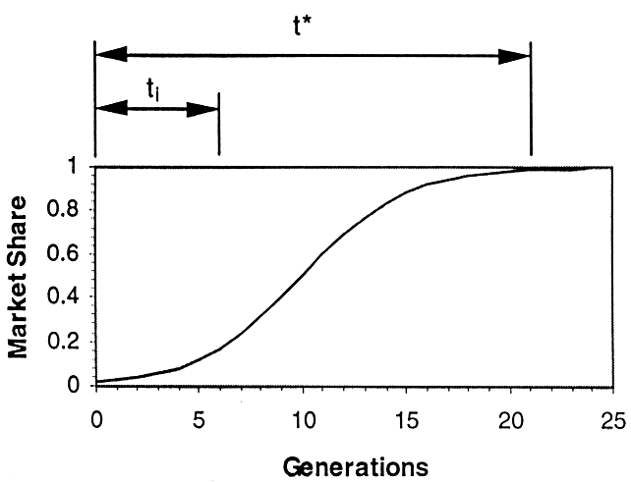
The Race
Takeover time and innovation time
Who should win?
We want innovation occurs before takeover

Slide 22
Mixing Boundary
Argument of the race.
Mixing time:

Slide 23
Drift Boundary
t_{d}=C_{d}n, where t_{d} is the drift time, and C_{d} is a constant.
For binary starting at 50% 1’s and 50% 0’s
C_{d}~1.4

Slide 24
Schema Theorem
Easy problems: ε=0
s>1, p_{c} anything.
Hard problems: ε=1

Slide 25
Cross Competition
Intuitive argument.
Consider truncation selection
Top 1/s th gets s copies
Diversity reduced to n/s individuals.
Assume p₀ schemata are correct.
GA fails when α errors.

Slide 26
Sweet Spot
Assume large enough fixed n.
How do we vary s and p_{c} to obtain successful convergence?
Mixing boundary
Innovation should occur before takeover.
Drift boundary
Takeover should be faster than drift.
Schema theorem
Good schemata should grow.
Cross competition
Selection pressure should be small to ensure diversity.

Slide 27
Control Map for Easy Problems
Mixing boundary
Drift boundary
Schema theorem
Cross competition

Slide 28
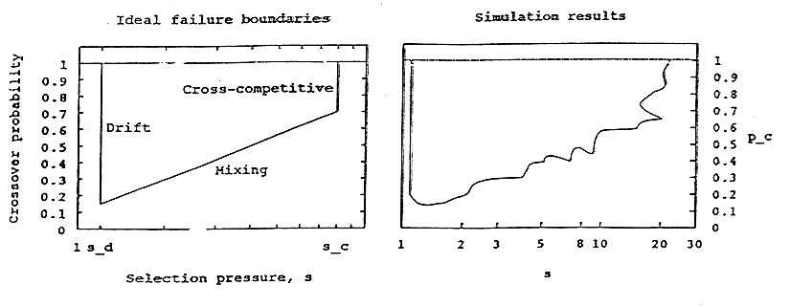
Control Map for Easy Problems (contd.)
Easy problems are no problem.
GA has a large “sweet spot.”
A monkey can set GA parameters.
Goldberg, Deb, & Thierens. (1993).
Toward a better understanding of mixing in genetic algorithms

Slide 29
Control Map for Hard Problems
You might be thinking about
Mixing boundary
Drift boundary
Schema theorem
Cross competition
But that’s exponentially difficult!

Slide 30
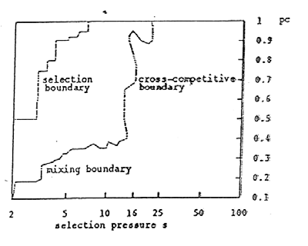
Control Map for Hard Problems (contd.)
Easy ➔ Hard
Only drift boundary is invariant.

Slide 31
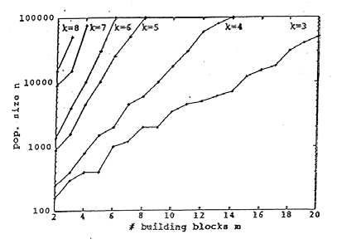
Simple GAs Are Limited
With growing difficulty, “sweet spot” vanishes.
Or populations must grow exponentially.
We will take about the remedy later.

Slide 32
Agenda
Schema theorem
Takeover & drift
Control map
Problem difficulty
BB hypothesis
Time-to-convergence
Population sizing
No-free-lunch (NFL) theorem

Slide 33
What Kind of Problems Are Difficult for GAs?
Piece of a solution: x* ∈ H*
Schemata superior to other pieces:
f (H*) > f (H_{competitors})
Intra: deception
Difficult to distinguish good schemata from their competitors. Let’s focus on this one for now.
Inter: scaling
Large population to conquer sampling noise. We will talk about this more in population sizing.
Extra: noise
Noisy fitness functions. We will talk about this in RWA.

Slide 34
Intra Difficulty
Do there exist problems that violate sampling and assembly assumptions?
Where low-order schemas go to one solution, but best solution is somewhere else.
Example
f (0**) > f (1**), and f (00*) > f (01*), f (10*), f (11*)
f (*0*) > f (*1*), and f (0*0) > f (0*1), f (1*0), f (1*1)
f (**0) > f (**1), and f (*00) > f (*01), f (*10), f (*11)
But f (111) is the best

Slide 35
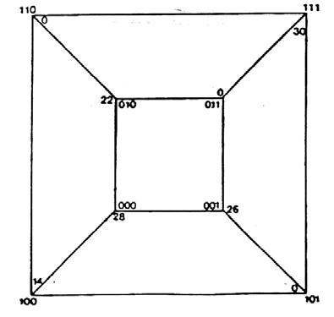
Designing a Hard Problem
Low-order estimates mislead GA.
x* = 111: f₁₁₁ > f_{i} , i ≠ 111.
Require complementary schemata better than competitors.

Slide 36
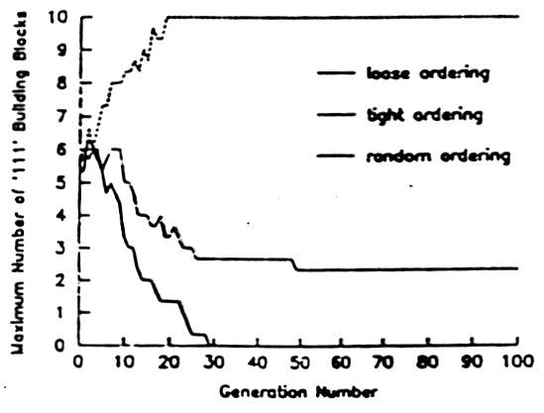
The Tight, the Loose, and the Ugly
30-bit problem as sum of 10 copies of order-3 subproblem.
Tight
abc*********
Loose
a***b***c***
Random
**a*b****c**
SGA only work for
tight ordering.

Slide 37
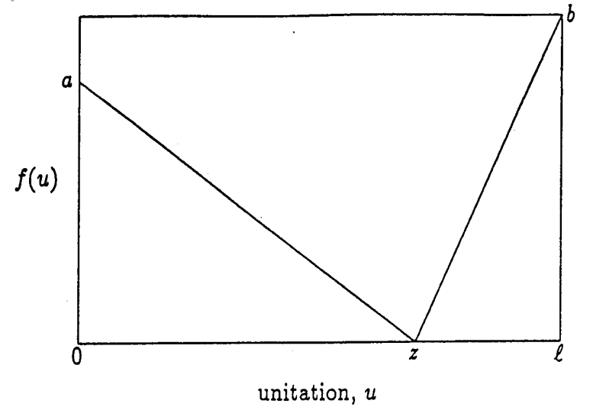
Trap Function
Ackley, 1985.
Local searcher would go to the wrong optima.
In general:
to be deceptive.
Goldberg & Deb (1993). Analyzing Deception in Trap Functions.

Slide 38
Agenda
Schema theorem
Takeover & drift
Control map
Problem difficulty
BB hypothesis
Time-to-convergence
Population sizing
No-free-lunch (NFL) theorem

Slide 39
Nearly Decomposable Problems
We do not want to solve every problem.
OneMax
NIAH
Too simple: simple heuristic, hill climbing
Too difficult: enumeration
Nearly decomposable problems

Slide 40
Building Block Hypothesis
Recall schema theorem
Minimal, sequential, superior schemata grow.
What about other schemata?
Inferior → we don’t care
High-order → should be further decomposed.
Not sequential → can we do something here?
Can we solve nearly-decomposable problems with bounded difficulty?

Slide 41
Power of Problem Decomposition
How to solve nearly decomposable problems?
Decomposition
100 bits → 20 x 5 bits
1.2x10³⁰ → 640 trials
How to decompose?
Learning problem structures
Data mining
Machine learning (Bayesian networks, decision trees, …)
Clustering

Slide 42
GA Design Theory
Goldberg, 1992.
Know what GA processes: Building blocks (BBs).
Ensure BB growth.
Know BB challengers.
Ensure BB supply.
Ensure BB speed.
Ensure good BB decisions.
Ensure good BB mixing (exchange).
Goldberg (2002), Design of Innovation.

Slide 43
Know What GA Processes: BBs
Minimal, sequential, superior schemata grow.
How many does GA processes?
A population of n binary strings of length l.
Consider only schemata that survive with a prob. > p_{s}
One-point XO: survival rate:
As a result, we consider schemata with

Slide 44
Know What GA Processes: BBs (contd.)
How many schemata with does one string contain?
Consider 1 0 1 1 1 0 0 0 1 0, and l_{s} = 5.
1 0 1 1 1 0 0 0 1 0
$ $ $ $ 1 0 0 0 1 0 , where $ is (0/1) or (*)
Initial population: such schemata
Duplicated counts of low-order schemata.
Clearly overestimate when n large.

Slide 45
Know what GA processes: BBs (contd.)
Initial population: such schemata
Focusing on a small population
Expect to have one schemata with order l_{s}/2 with specific 0 or 1.
Therefore, if we count schemata with order higher than l_{s}/2 , there would be little (or no) duplication.
such high-order schemata.
If
ϴ(n³) schemata with in the population.

Slide 46
Know What GA Processes: BBs (contd.)
GA processes ϴ(n³) schemata with survival prob. greater than some threshold.
Implicit parallelism (Holland).
Goldberg (1985), Optimal initial population size for binary-coded genetic algorithms.

Slide 47
GA Design Theory (contd.)
Know what GA processes: Building blocks (BBs).
Ensure BB growth
Schema theorem : make it short defining length
Know BB challengers.
Deceptions
Ensure BB supply.
Population sizing
Ensure BB speed.
GA convergence
Ensure good BB decisions.
Population sizing
Ensure good BB mixing (exchange).
Mixing

Slide 48
Meaning of BBs
From Holland
Low order, short defining length, and highly fit shemata
To Goldberg
More centered at positions
A group of highly interacting genes
Problem decomposition
What’s next?
To group or not to group? Based on n_{fe}?
Fuzzy-like grouping?
BBs on real-values?

Slide 49
Agenda
Schema theorem
Takeover & drift
Control map
Problem difficulty
BB hypothesis
Time-to-convergence
Population sizing
No-free-lunch (NFL) theorem

Slide 50
GA Timing
Takeover time.
Selection only
Drift time.
Converge with no good reason
Convergence time.
Perfect mixing & selection

Slide 51
Drift Again
Gambler’s ruin problem (Feller, 1970)
A gambler with a fix stake D dollars
Successive, one-dollar wagers
Unbiased coin toss
Goal value A dollars
Either ruin (lose all D dollars) or reward (win A dollars)
The expected number of coin toss is D(A-D)
Drift
D=np₀, A-D=n(1-p₀)
Normalize by dividing by # of steps taken per gen: n/6
More accurate model: Goldberg & Segrest (1987), Finite Markov chain analysis of genetic algorithm

Slide 52
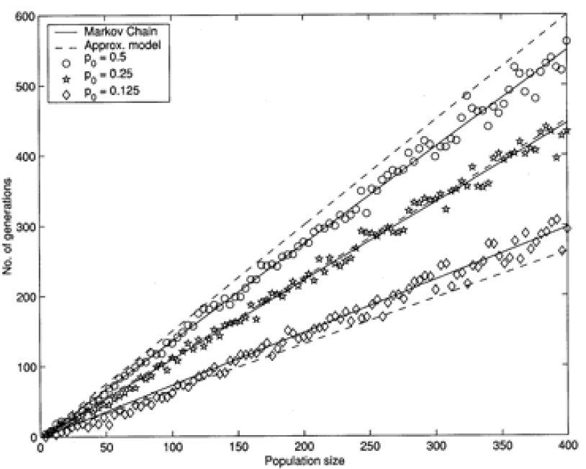
Drift Again (contd.)
t_{d}=6p₀(1-p₀)n
More accurate models with Markov chain.

Slide 53
Convergence Time
Fisher’s theorem & selection intensity
Selection intensity:
For many selections, I_{t} is invariant with t
For tournament selection
Blickle & Thiele, 1995.
For truncation selection
: pdf of Guassion, Φ: cdf
Bäck, 1995.

Slide 54
Thierens’ Performance Model
Thierens & Goldberg, 1994
Assume perfect mixing
Approximate difference by differential

Slide 55
Thieren’s Performance Model (contd.)
Let y=2p(t)-1

Slide 56
Convergence Time
y=2p(t)-1
For p(0)=0.5
Convergence time: solving

Slide 57
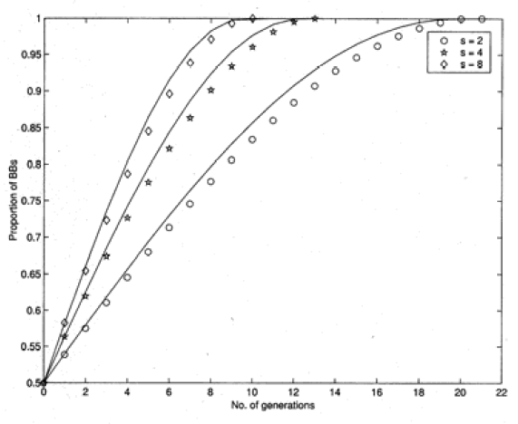
Experiments

Slide 58
Domino Convergence
Previous analysis is for uniform salience only.
Every bit converges at the same rate
What about other kinds?
Exponential salience
BigInt
|f(1*****)-f(0*****)| > |f(011111)-f(000000)|
Before the 1st gene converges, other genes don’t matter.
The population converges gene by gene.

Slide 59
Conclusions on Convergence Time
Uniform salience
Exponential salience
Domino convergence
Be careful, do not let less salient genes drift before more salient genes converge.
Problem with m uniformly scaled BBs of order k
p(0)=1/2^{k} ~ 0
l → m

Slide 60
Agenda
Schema theorem
Takeover & drift
Control map
Problem difficulty
BB hypothesis
Time-to-convergence
Population sizing
No-free-lunch (NFL) theorem

Slide 61
Population Size
BB supply
Goldberg et al. On the supply of building blocks, 2001.
Decision making
Goldberg et al. Genetic algorithms, noise, and the sizing of populations, 1992.
Decision making + supply
Harik et al. The gambler's ruin problem, genetic algorithms, and the sizing of populations, 1997.
Model building
Yu et al. Population sizing for entropy-based model building in genetic algorithms, 2007.

Slide 62
BB Supply
Initial population needs to supply enough BBs for GA to process.
Consider one BB of order k
Alphabet cardinality χ
Success in randomly generated population of size n
Or, to be more precise

Slide 63
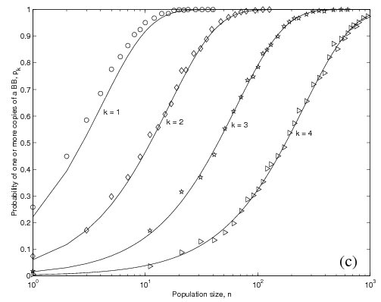
BB Supply Verification
χ=4

Slide 64
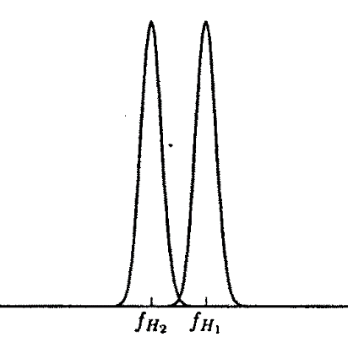
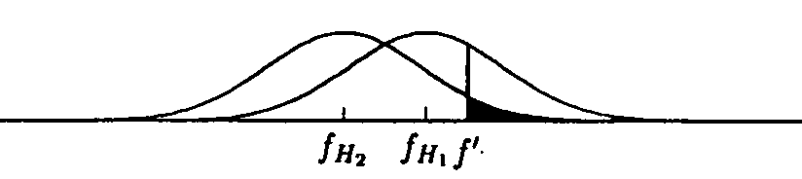
Decision Making
Population size needs to be large enough for GA to distinguish a good BB from its competitors.
H₁ be the correct BB, H₂ be its most competing schema.
, ,
Large n
Small n
Central Limit Theorem

Slide 65
Decision Making (contd.)
Define decision-making variable
For large z
Again, for large z

Slide 66
Decision Making (contd.)
Let α=1/m and
for large m
Or more generally,

Slide 67
Gambler’s Ruin Model
Decision-making model
Consider only one generation
No recover from one error
Let’s consider random walk on one BB
x : number of correct BBs in the population
Initially, x₀=n/2^{k}
2 absorbing boundaries: x=0 and x=n
Let f(x) be the prob. that the particle is captured at position n starting from position x
Difference Eq: f(x) = p f(x-1)+(1-p) f(x+1)
p: prob. that the gambler wins (making correct decision between the correct BB and its competitors)

Slide 68
Gambler’s Ruin Model (contd.)
Prob. of capture
Can’t be easily solved by
difference equations
Differential approximation
f(x) = p f(x-1)+(1-p) f(x+1)
(1-p) f(x+1)-f(x)+pf(x-1) = 0
(1-p) (f(x+1)-f(x)) - p(f(x)-f(x-1)) = 0
(1-p)f’(x+1) – pf’(x) = 0
(1-p)f’(x+1) – (1-p+2p-1)f’(x) = 0
(1-p)f’’(x) – (2p-1) f’(x) = 0
Boundary conditions: f(0) = 0 and f(n)=1

Slide 69
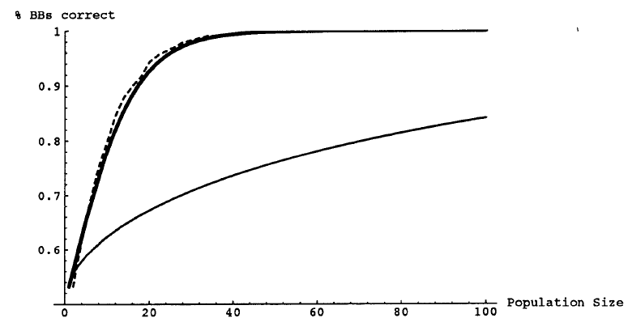
Gambler’s Ruin Model (contd.)
Gambler’s ruin
Decision-making
Harik et al. (1997). The Gambler's Ruin Problem, Genetic Algorithms, and the Sizing of Populations.

Slide 70
Agenda
Schema theorem
Takeover & drift
Control map
Problem difficulty
BB hypothesis
Time-to-convergence
Population sizing
No-free-lunch (NFL) theorem

Slide 71
No Free Lunch Theorem (NFL)
Wolpert & Macready, 1995, 1996
Watanabe’s ugly duckling theorem, 1969
Mitchell’s inductive bias, 1980
When averaged over the space of all possible problems, all procedures are equally efficient.
Some may be better than others on some problems, but this superiority must be counterbalanced by inferiority somewhere else.

Slide 72
NFL
Consider only non-trivial algorithms
Do not check a particular point over and over again.
NFL holds iff the space of all possible problems is of permutation form (Whitley, 2000)

Slide 73
One Problem, Three Algorithms
P1
Global Optimum
Search Space
P2
P3
Algorithm A1 : P1 → P2 → P3
Algorithm A2 : P3 → P1 → P2
Algorithm A3 : P2 → P3 → P1
A1 better than A2 better than A3 on this problem.

Slide 74
All Problems, Three Algorithms
P1
P1
P1
P2
P2
P2
P3
P3
P3
A1>A2>A3
A3>A1>A2
A2>A3>A1
Algorithms
A1 : P1 → P2 → P3
A2 : P3 → P1 → P2
A3 : P2 → P3 → P1
Performance
A1 : 1st , 2nd , 3rd
A2 : 2nd , 3rd, 1st
A3 : 3rd , 1st , 2nd

Slide 75
Implications of NFL
We don’t need to design new search algorithms?
Suggesting that one algorithm is as good as another ignores the facts
Users are uninterested in random problem instances and have prior preferences.
Users are willing to pay more for more difficult problems than easier ones.
Algorithms can be designed to provide acceptable and scalable performance.

Slide 76
Little Models
Low Cost
High Error
High Cost
Low Error
Unarticulated
Wisdom
Articulated
Qualitative
Models
Facetwise
Models
Equations
of Motion

Slide 77
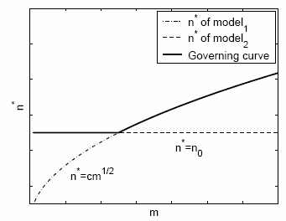
Patchquilt Integration
Pop size: n
# of BBs: m
Model₁: n*=n₀
Model₂: n*=cm^{1/2}
Larger governs (probabilistic argument).
Formal asymptotics & blends smoother.

Slide 78
Final Words
Exact equations to analyze GAs → tough
Make reasonable assumptions, and derive little models to gain insights.

Slide 79
What’s Next?
Issues about RWA
From binary to real
Permutation problems
Problems with constraints
Noisy evaluations
Niching techniques on multi-modal problems
Multi-objective optimization
Efficiency enhancement techniques

